Slide 1
hour 5
Lighting and Rendering

Slide 2
Introduction
In this lecture, you will learn to work with Light Actors.
You will look at the types of lights available. Then you will learn how to modify settings for Light Actors and control how they affect other Actors in the world.
Although lights are some of the most common types of Actors to place in a Level and edit, understanding how they work and interact with other Actors and how to apply rendering settings are difficult skills to master.

Slide 3
Lecture Goals and Outcomes
Goals
Outcomes
The goals of this lecture are to
Become acquainted with lighting terminology
Learn to use different types of lights
Learn how to apply light properties
Learn how to build lighting
Learn to use Mobility settings
By the end of this lecture you will be able to
Use different types of lights
Apply light properties
Build lighting for your project
Use Mobility settings

Slide 4
Lighting Terminology
Basic Concepts

Slide 5
Lighting and Rendering: Lighting Terminology
Direct lighting refers to light that falls on the surface of an Actor, without any interference from other Actors. The light travels directly from the light source to the surface of the mesh. So the Static Mesh Actor receives the full color spectrum of the light.
Indirect or bounced lighting refers to light that has been reflected off the surface of another Actor in the scene. Because light waves are absorbed or reflected based on the surface properties and colors of a mesh, the reflected light takes on some of the color information and also passes it on to the next surface in its path. Indirect lighting affects the overall scene light intensity.
Shadows are created when the engine takes a snapshot of the silhouette of a mesh from the light’s point of view and then projects that image onto the surface of other Actors on the inverse side of the lit mesh Actor. Both Static Mesh Actors and Light Actors have shadow properties that can be selected.

Slide 6
Lighting and Rendering: Lighting Terminology
Static lighting refers to lighting for objects and lights that do not move. For things that don’t move, lighting and shadows have to be calculated only once (during build), which results in better performance and high quality.
Dynamic (movable) lighting refers to lights and objects that may move at runtime. Because this type of lighting is calculated every frame during runtime, it is often slower and lower quality than static lighting.
Light attenuation is the reduction of light intensity based on distance.

Slide 7
Light Types
Basic Concepts

Slide 8
Common Light Types
There are four basic Light Actors in Unreal Engine:
Directional Light
Point Light
Spot Light
Sky Light
They all have some similar property settings. However, each Light Actor type also has settings that are unique.

Slide 9
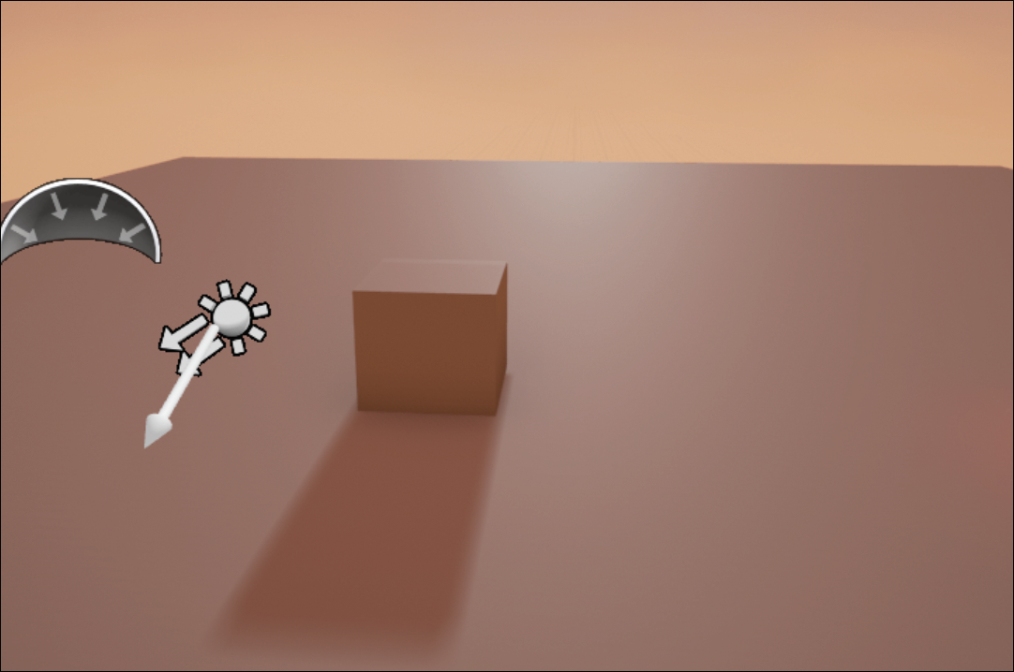
directional Light
A Directional Light simulates light that is being emitted from a source that is infinitely far away.
All shadows cast by a Directional Light will be parallel, making this light the ideal choice for simulating sunlight.
When using a Directional Light in your Level, it does not matter where you place it, only the direction it is facing.

Slide 10
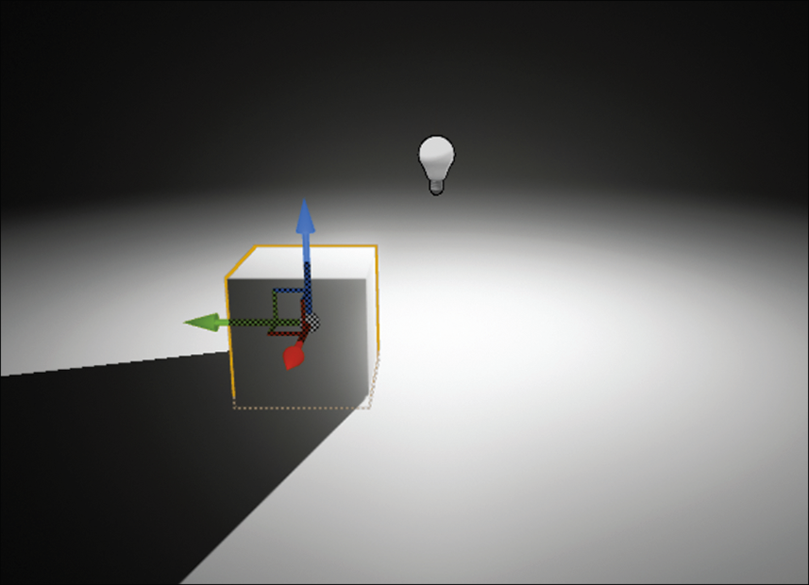
Point Light
A Point Light works much like a real-world lightbulb, emitting light equally in all directions from a single point in space.
It is the most common light type, particularly for indoor scenes.

Slide 11
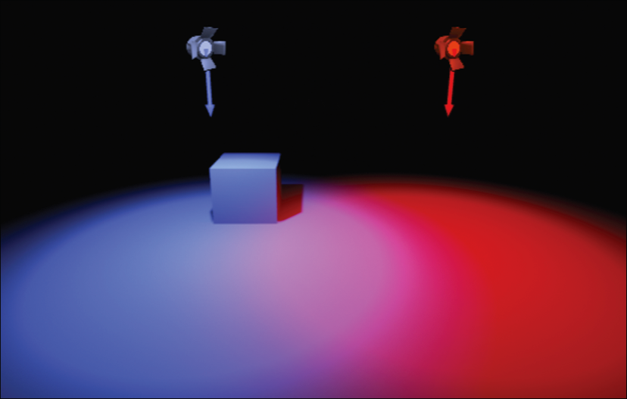
Spot Light
A Spot Light emits light from a single point in a cone shape toward a specific direction, just like a spotlight in the real world.
The Spot Light direction is set by changing the Spot Light Actor’s Rotate transform.
You can adjust the attenuation to set the distance the light travels from where the Spot Light is placed.
The Inner Cone and Outer Cone angle properties affect how quickly light changes from full intensity at the center of the cone to no light at the edges. The closer these values are to one another, the harder the edge of the light will be.

Slide 12
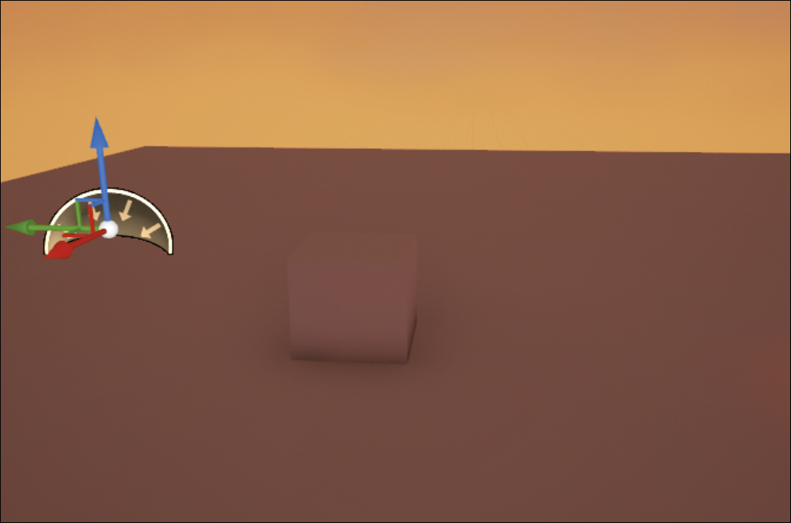
Sky Light
A Sky Light captures the distant parts of a Level—everything farther than SkyDistanceThreshold—and applies that to the scene as a light.
The sky’s appearance and its lighting and reflections will match, even if the sky is coming from atmosphere, or layered clouds on top of a skybox, or distant mountains.
Using a Sky Light is a good way to brighten up an entire Level and affect shadow colors.
A Sky Light does not cast dynamic shadows.

Slide 13
Light Properties
Common Light Properties

Slide 14
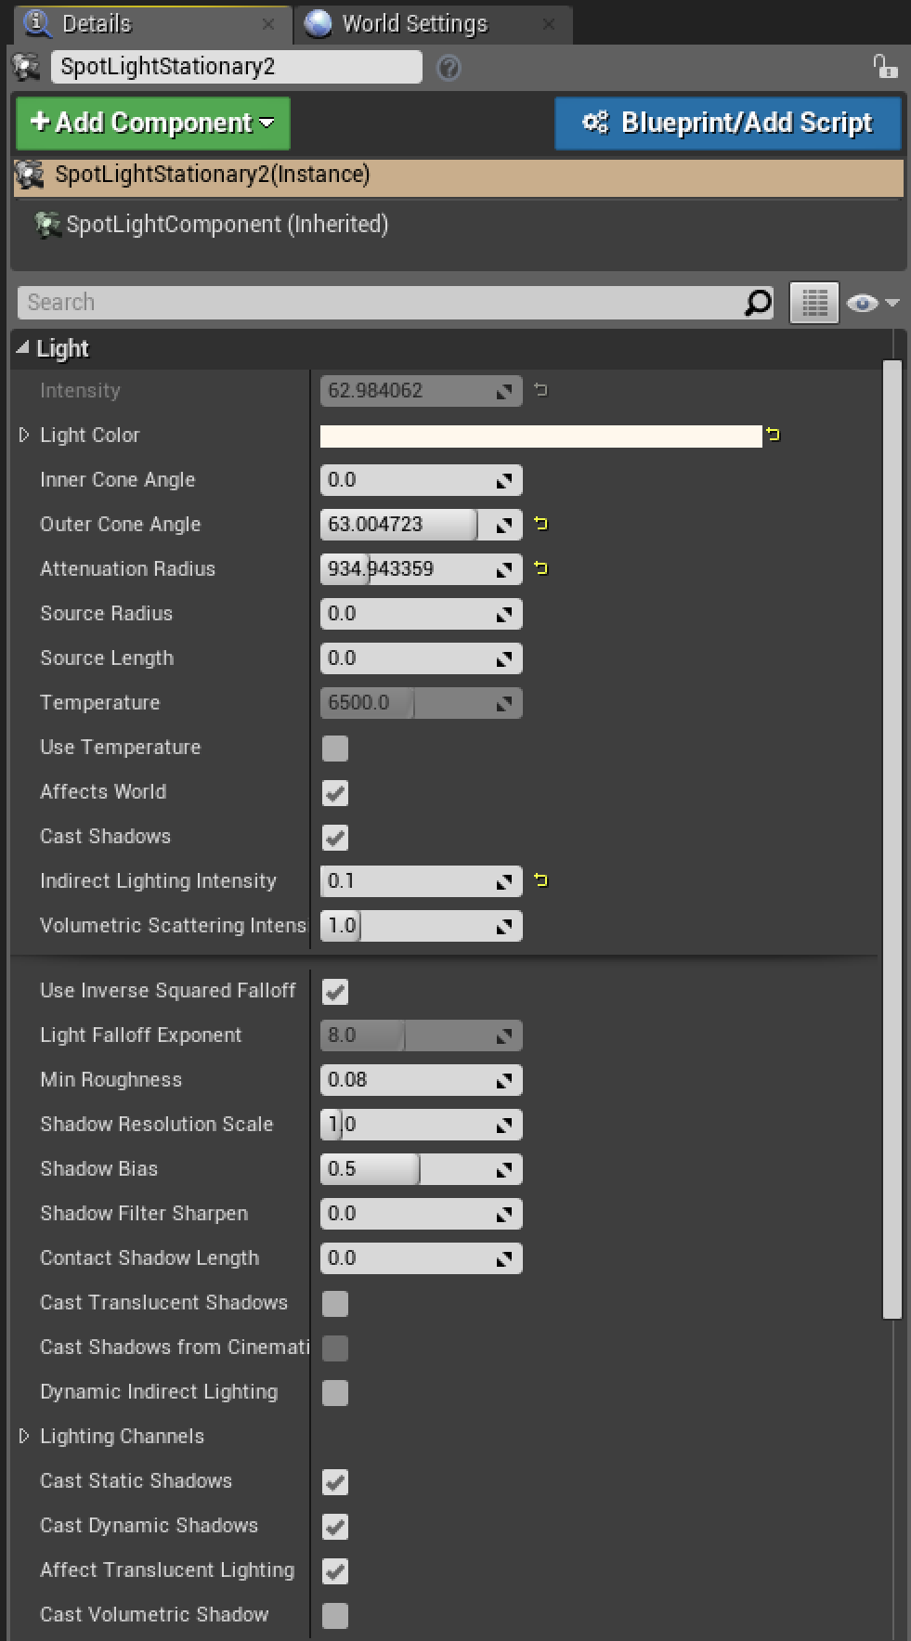
Light Properties
The Properties tab of each light in a scene shows a number of properties. There are many properties, giving you total control over the lighting in a game.

Slide 15
Property | Description
Intensity | Determines the brightness of the light, in lumens, for Point Lights and Spot Lights, where 1700 lumens corresponds to a 100W bulb.
Light Color | Determines the color the light shines. Color is additive, so if you shine a red light on a blue object, it ends up purple.
Attenuation Radius | Determines the maximum distance the light will reach. Illumination fades from maximum at the source of the light to zero at the edge of the radius.
Cast Shadows | Determines whether objects affected by the light cast shadows. Calculating dynamic shadows can be processor intensive.
Inside Cone Angle | Sets the angle in degrees of a Spot Light’s bright area.
Outside Cone Angle | Sets the angle in degrees of a Spot Light’s falloff area. If this is close to the inside angle, your Spot Light area will be sharp.
Temperature | Allows you to set the color of a light based on Kelvin color temperature scale. This is great if you are trying to match real-world light colors. You need to toggle on the Use Temperature property in order to set this.
Common Light Properties

Slide 16
Performance
Poorly chosen light settings can have a major effect on performance.
Using too many dynamic, shadowed lights can cause serious performance issues.
A light’s attenuation radius can have a serious impact on performance, so use larger radius values sparingly.

Slide 17
Mobility Settings
Static, Stationary, Movable

Slide 18
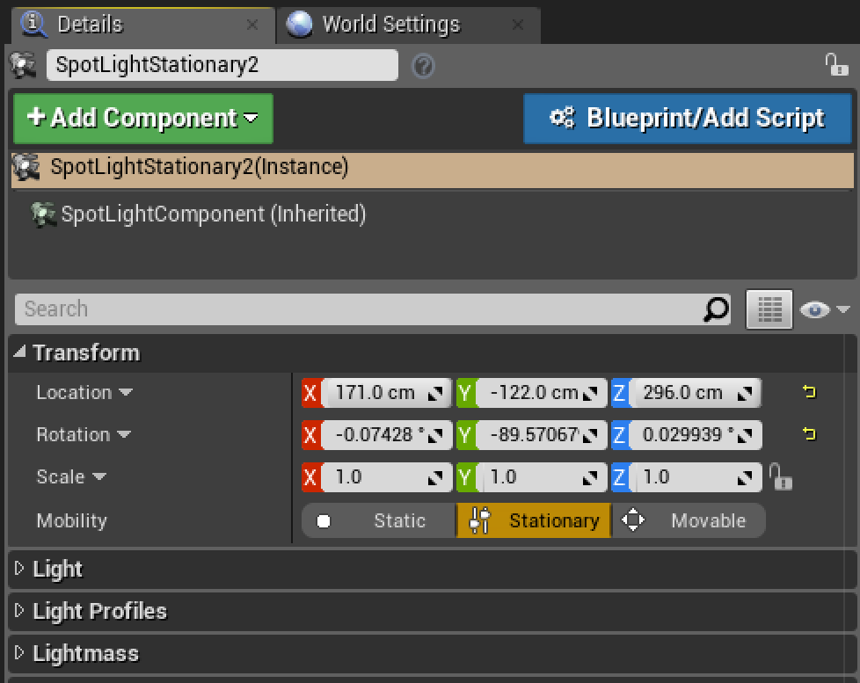
Mobility Settings
Every Light and Static Mesh Actor has a Mobility option for which you can choose Static, Stationary, or Movable.
These settings tell UE4 what to light dynamically and what to precalculate and save (bake) in a lightmap.

Slide 19
Setting | Description
Static | Static lights are lights that cannot be changed or moved in any way at runtime. The lighting information is built prior to gameplay and stored in a special Texture called a lightmap. Static light gives high performance but does not work with movable objects within the light’s radius. The primary reason to use the Static setting is for performance, such as on mobile devices.
Stationary | Stationary lights are similar to static lights in that they cannot move; however, their brightness and color can be changed at runtime. This can be useful, for example, on lights that can be turned on and off that are not movable. The Stationary setting gives medium performance and high quality.
Movable | Movable lights cast completely dynamic light and shadows, and they can change position, rotation, color, brightness, falloff, radius, and just about every other property they have. None of the light they cast gets baked into the lightmaps, and they cannot have any indirect lighting. These lights are usually expensive to render and are not as high quality as static or stationary lights. You might use a movable light on a character that moves, such as a player holding a flashlight.
Mobility Settings

Slide 20
Building Lighting
Lightmass

Slide 21
Lightmass
Lightmass is UE4’s offline global illumination (GI) rendering engine and is used to calculate lighting for Light and Static Mesh Actors with Static mobility.
You use the lighting build tools in UE4 to precalculate lighting and shadow information in a Level for Static Mesh and Light Actors with a Mobility setting of Static and for BSPs.
Note: This information is stored as images embedded in the Level, which you can find by selecting Window > World Settings > Lightmass > Lightmaps.

Slide 22
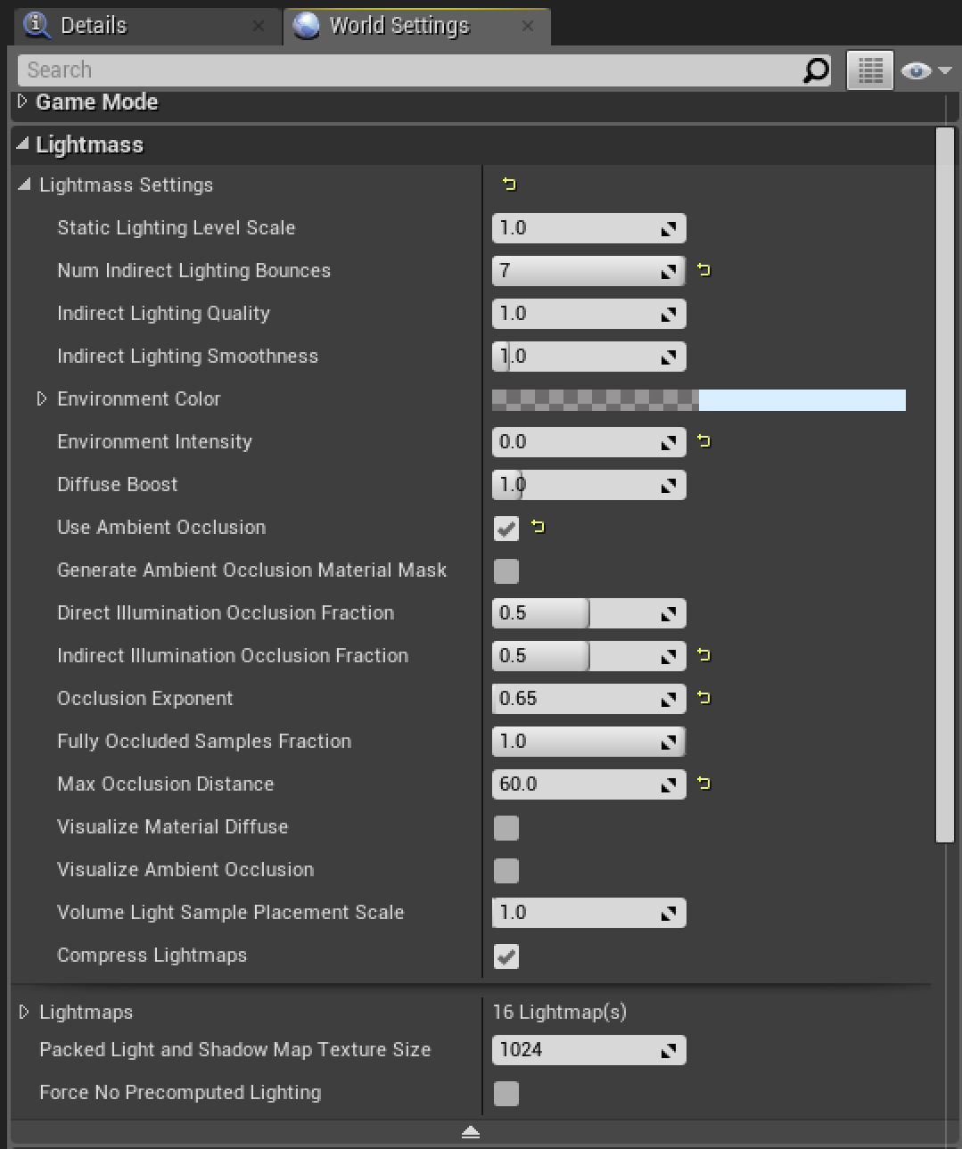
Lightmass
Lightmass has many settings that can be found in various places. The general settings for Lightmass are located under World Settings.
Note: To open World Settings for the current Level, go to Window > World Settings.

Slide 23
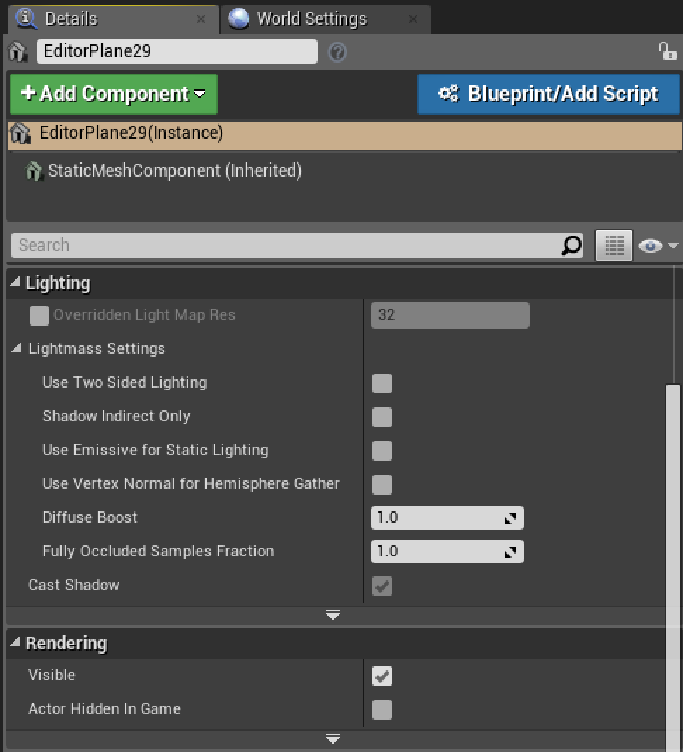
Lightmass
Many Actors have their own properties that determine how they behave with Lightmass.

Slide 24
building lighting
To build lighting:
Click the down arrow on the Build button on the toolbar.
In the submenu that appears, select Lighting Quality > Preview to get quick results.
When you’re ready with your final Level, select Lighting Quality > High. High quality takes longer to generate but gives more accurate results.

Slide 25
Building Lighting
The engine can render all lights and meshes in a Level with dynamic lighting, but doing so affects both performance and quality.
If UE4 knows that a light will not move, it can precalculate the lighting and shadows for that light and all static Actors in the world that it touches.
While storing precalculated lighting is less processor intensive during gameplay, it does require memory usage.

Slide 26
Building Lighting
Every time you move a light that is set to cast static shadows or a Static Mesh Actor with a Mobility setting of Static, the Editor reminds you to build lighting. The more lights and objects you have, the longer it takes to rebuild the lighting.
Note: When working with light, it is best to follow an iterative process and build lighting only when significant changes have been made. You can preview and playtest the Level without rebuilding the lighting, but the lighting won’t be correct until you rebuild it.

Slide 27
Adjusting Lightmap Resolution
You can override the Lightmap resolution quality on a per-Actor basis in your Level as needed, or you can change the default Lightmap resolution on the Static Mesh asset in the Static Mesh Editor.
Increasing the resolution will have an effect on lighting build times.

Slide 28
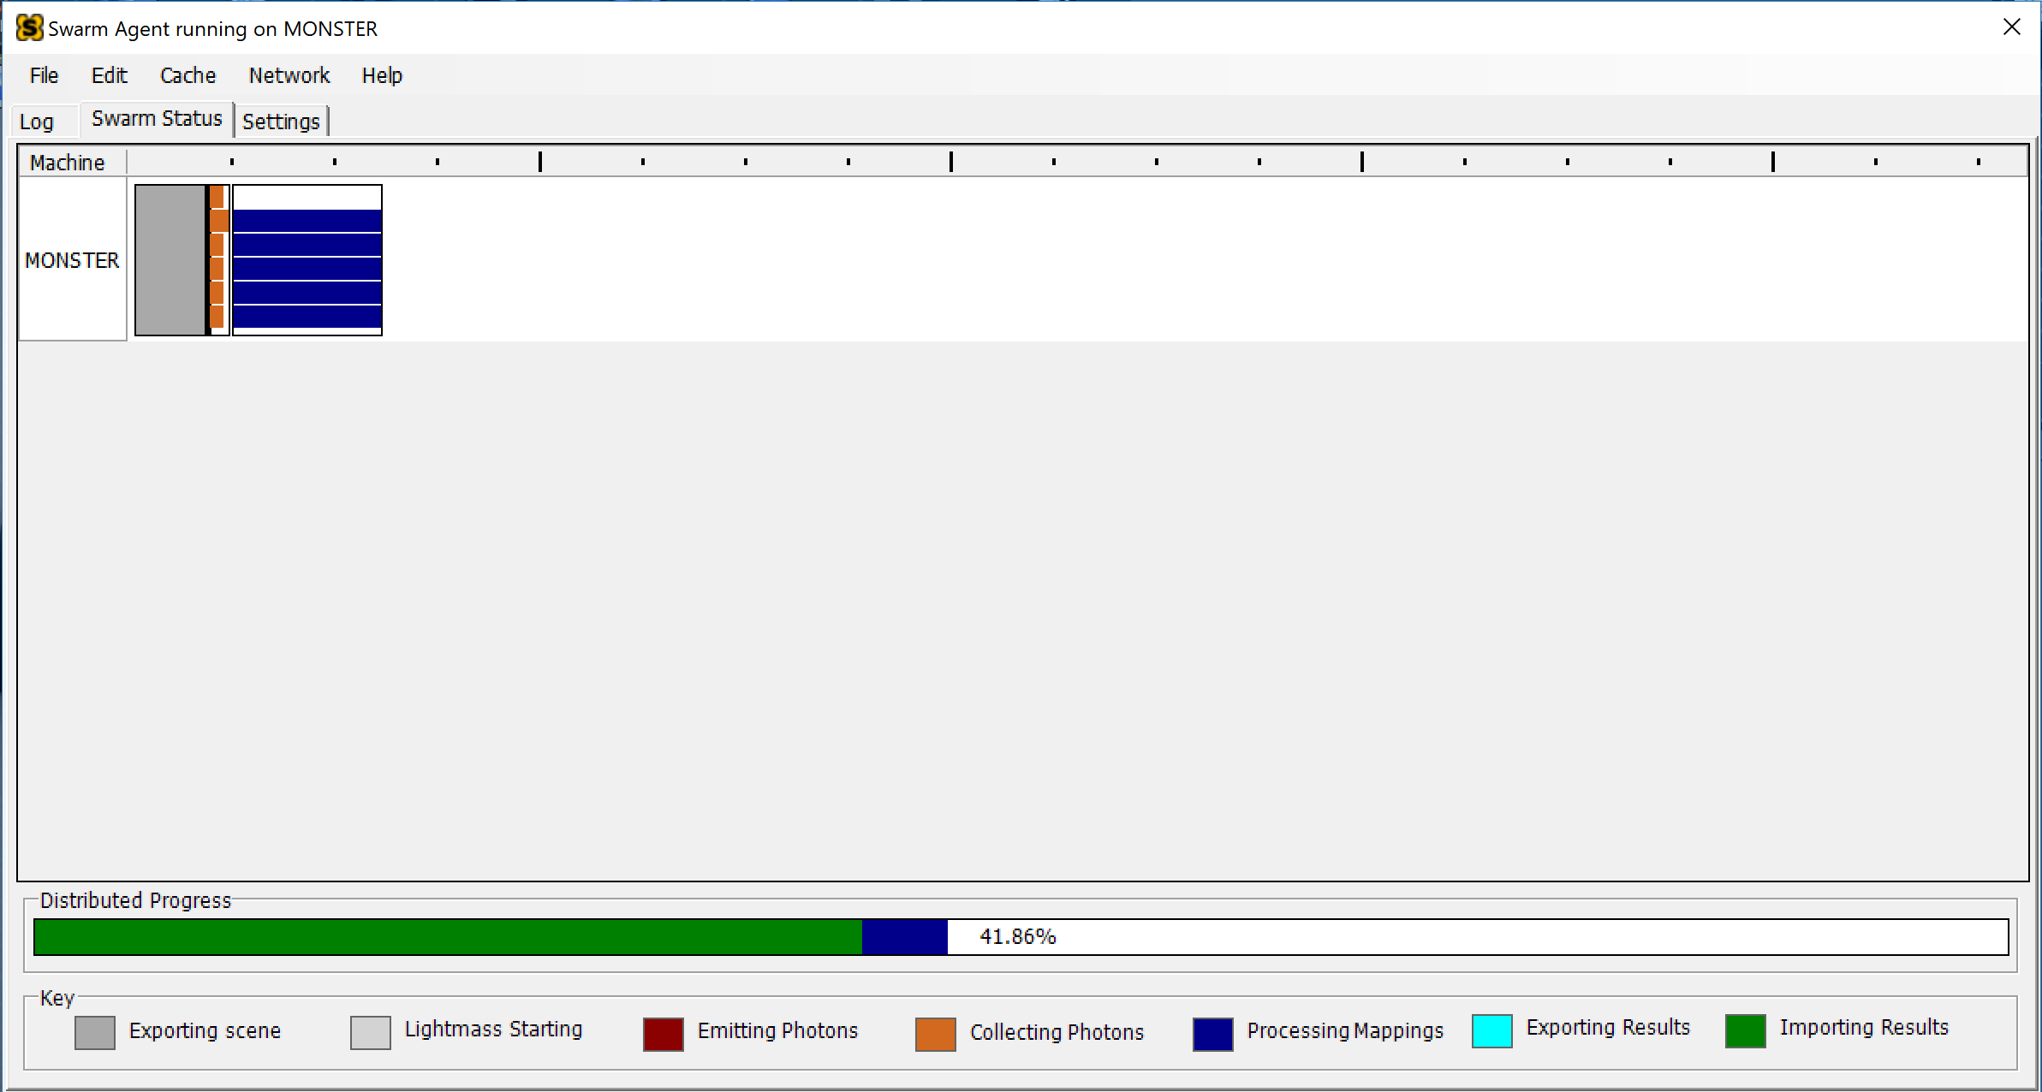
Swarm Agent
Swarm Agent manages communication between the Editor and Lightmass. When you build lighting, Swarm Agent keeps track of and displays the build progress.
Note: As the complexity of a Level increases, so does the amount of time it takes to calculate and build lighting.

Slide 29
Swarm Agent
Swarm Agent can also be set up to communicate with remote machines on a network and utilize their processing power to reduce the amount of computing time.

